Slide 1
SMART SURVEYING DEVICE FOR RESOURCE OPTIMIZATION
Team Name : Debug Thugs
Team Members : Ushasree
Navya
Priyanka
Lavanya

Slide 2
ABSTRACT
This device can be integrated in the place where we want to monitor different parameters. By using this data the authorities can take the necessary steps and make efficient arrangements which will be helpful for their employees. Features: Counting the number of people entering the conference hall and monitoring their time patterns.
Counting the number of vehicles entering the parking area and monitoring their time patterns.
Crowd estimation in an area

Slide 3
PROBLEM STATEMENT
In corporate offices and other industries there are some common resources which are used by different people in that industry. Sometimes there will be the chances that the resources would be more or insufficient. This would be the drawback

Slide 4
PROJECT WORKING PROCESS
Face Detection is a computer vision technology that helps to locate/visualize human faces in digital images. This technique is a specific use case of object detection technology that deals with detecting instances of semantic objects of a certain class (such as humans, buildings or cars) in digital images and videos. With the advent of technology, face detection has gained a lot of importance especially in fields like photography, security, and marketing.

Slide 5
PROJECT HIGHLIGHTS
Crowd Detection using Open Cv.
Counting the number of persons and vehicles entering and leaving particular place.
ThingSpeak Cloud Integration between Gateway and Mobile App
Data Analytics and Visualization in Web Application.

Slide 6
PRE-REQUISITES
Hands-on knowledge of Numpy and Matplotlib is essential before working on the concepts of OpenCV. Make sure that you have the following packages installed and running before installing OpenCV.
Python
Numpy
Matplotlib
Dlib

Slide 7
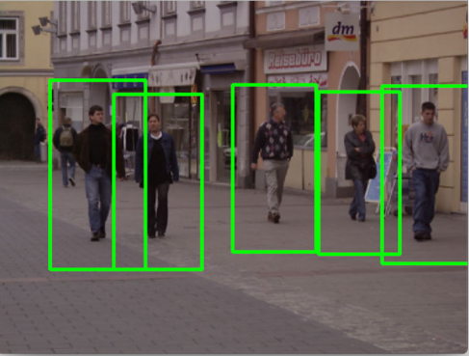
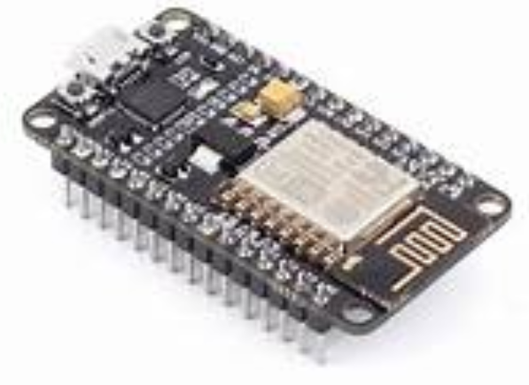
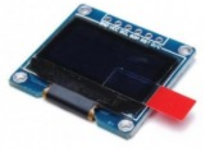
HARDWARE REQUIREMENTS
NodeMCU
OLED
Camera

Slide 8


